Slide 1
Fundamentals of Signal Processing: Analog and Digital Techniques
Akbar Q – Calander Week 5Mechatronics Engineering Year 1

Slide 2
Introduction to Signal Processing
Definition of Signal Processing
Importance of Signal Processing in Real-World Applications (e.g., audio, communication, medical devices, etc.)
Overview of Analog vs. Digital Signal Processing

Slide 3
Analog Signal Processing Overview
Filters
Amplifiers
Attenuators

Slide 4
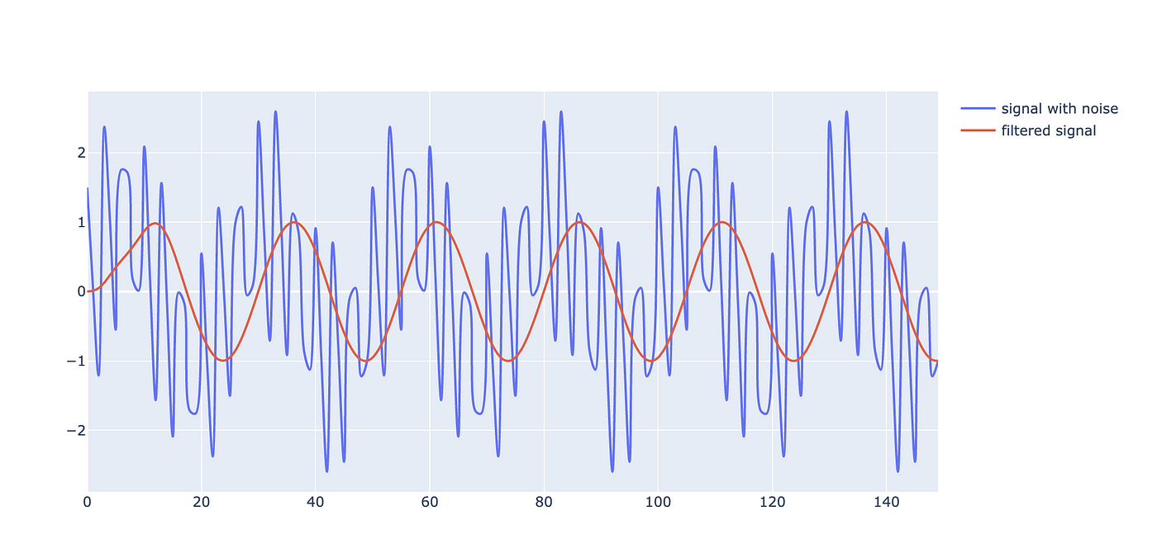

Slide 5
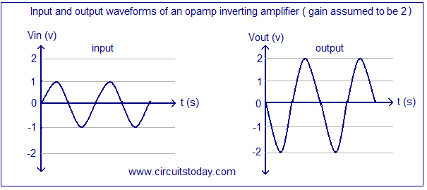

Slide 6
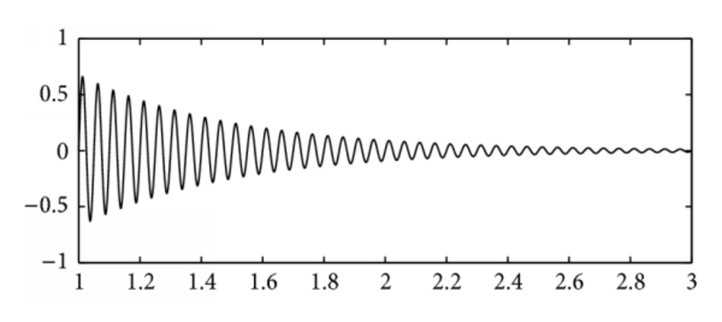

Slide 7
FILTERS IN ANALOG SIGNAL PROCESSING
Types of Filters:
Low-Pass Filters (LPF)
High-Pass Filters (HPF)
Band-Pass Filters (BPF)
Band-Stop (Notch) Filters

Slide 8
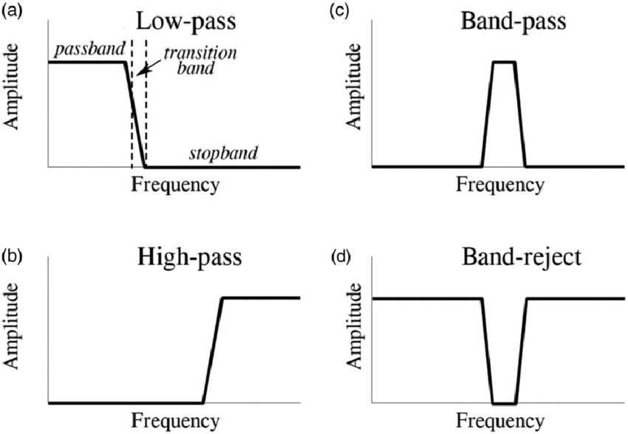

Slide 9
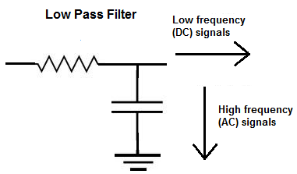

Slide 10
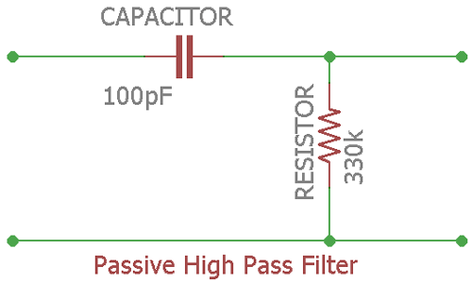

Slide 11
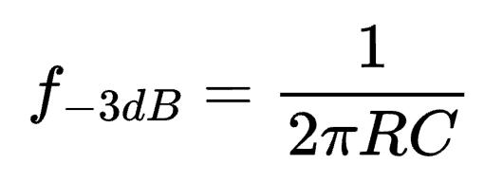
Low pass and high pass formula

Slide 12
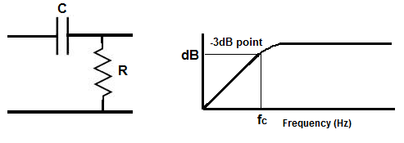
-3db is when power output is half

Slide 13

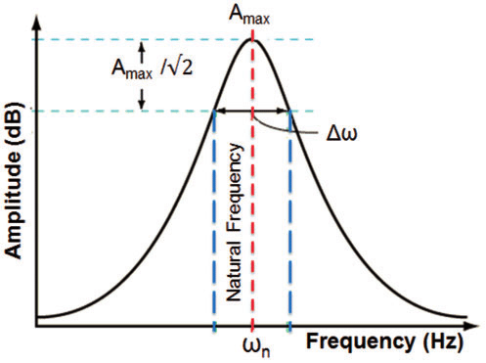
Power halves
Power is Voltage x Current

Slide 14
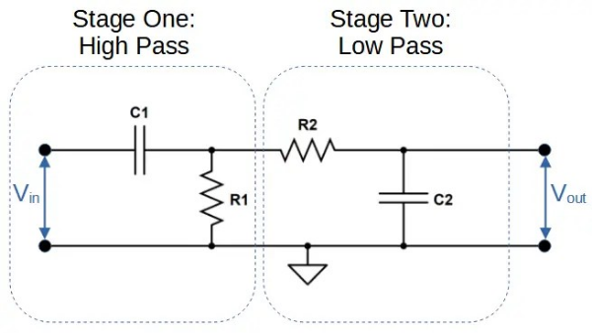

Slide 15
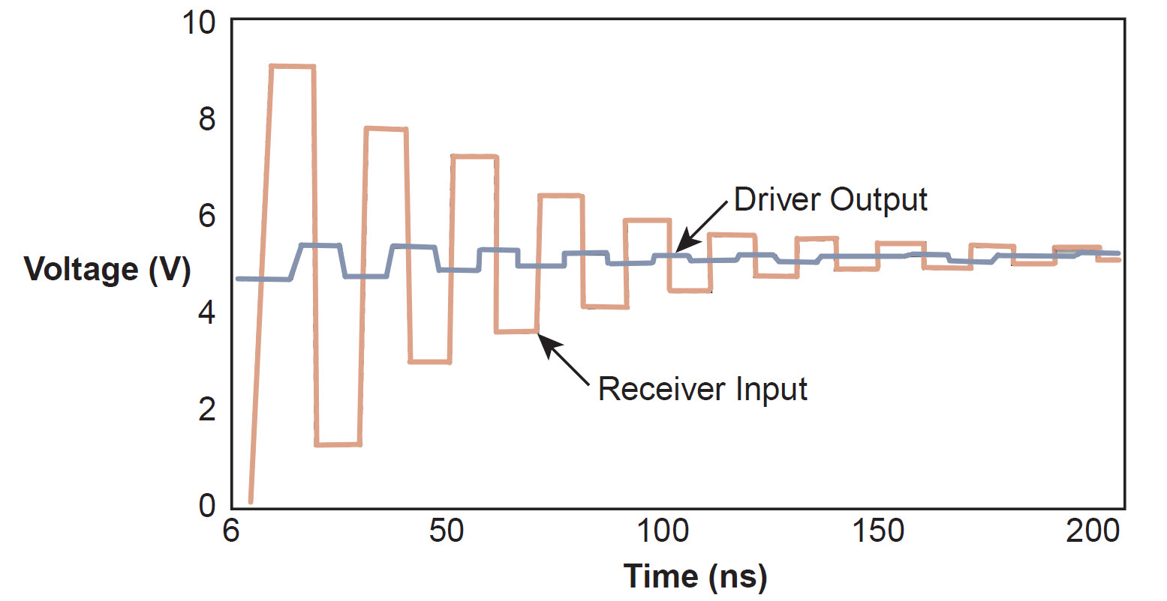

Impedance mismatch
Impedance of the filter is difficult to control with a passive filter
Active Filters can be Used to Increase Current Drive
Also to control impedance

Slide 16
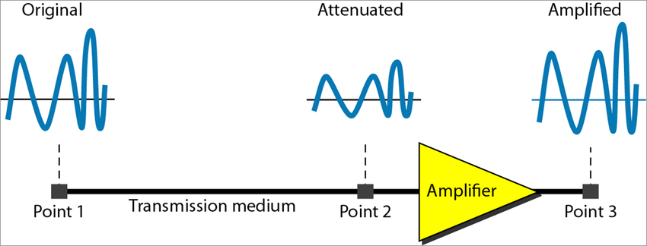
We need to recover losses

Slide 17
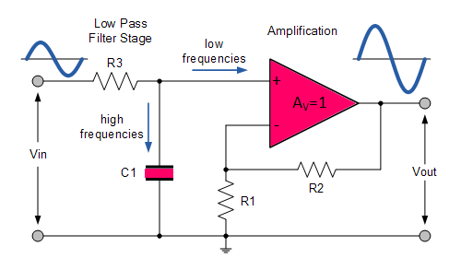

Slide 18
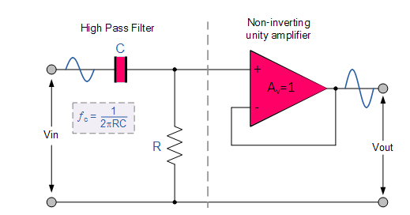
Unity Voltage Gain Mode

Slide 19
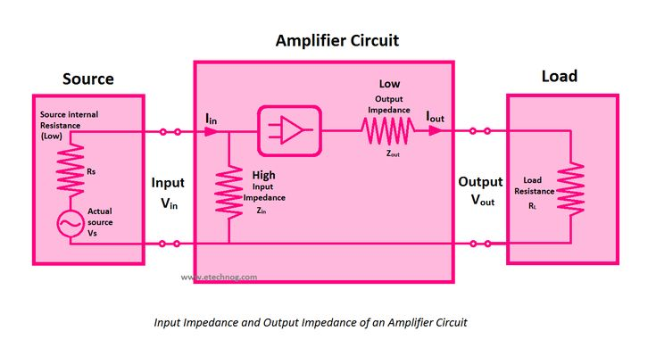
Why is unity voltage gain useful?
Increases Current Drive at the Output
Decouples the Load Current from Sensitive Source
Maintains the Same Signal Shape

Slide 20
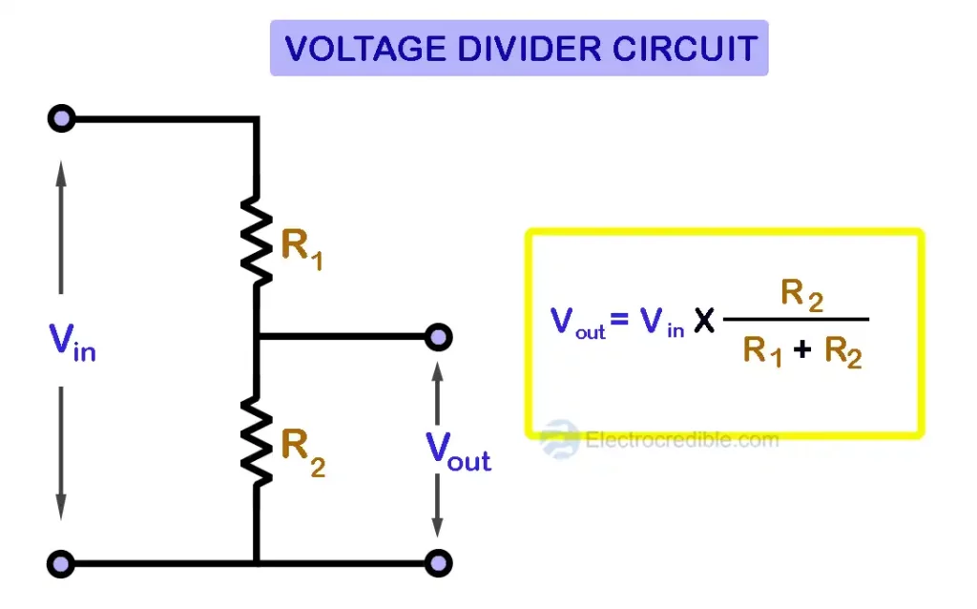
Sometimes the voltage needs to be reduced
Scales down voltage to fit within ADC range
Eg, the ESP32 can measure upto 1.1V without internal dividers but with a 1:10 division it could measure much higher voltage like 24V

Slide 21
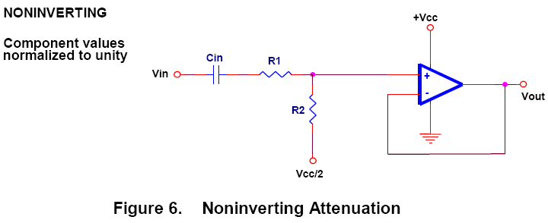
Opamps can be used for attenuation given the signal fits within the opamp supply voltage rails

Slide 22
Caveats of Using Op-Amps in Real-World Signal Processing 1
Input Offset Voltage:
Small voltage difference between the inverting and non-inverting inputs.
Causes DC error in the output, especially in high-gain applications.
Requires external trimming or offset nulling circuits.
Input Bias Current:
Small current flowing into the input terminals.
Can cause voltage drops across input resistors, leading to errors.
Critical in high-impedance circuits.
Input Offset Current:
Difference between the bias currents of the two input terminals.
Exacerbates errors in precision applications.

Slide 23
Caveats of Using Op-Amps in Real-World Signal Processing 2
Limited Bandwidth:
Op-amps have a finite gain-bandwidth product (GBW).
High-frequency signals may experience attenuation or phase shift.
Slew Rate Limitation:
Maximum rate of change of the output voltage.
Limits the op-amp’s ability to handle fast-changing signals, causing distortion.
Non-Rail-to-Rail Operation:
Many op-amps cannot swing their output voltage to the supply rails.
Reduces dynamic range, especially in low-voltage applications.
Power Supply Limitations:
Op-amps require stable and clean power supplies.
Noise or fluctuations in the supply can affect performance.

Slide 24
Caveats of Using Op-Amps in Real-World Signal Processing 3
Temperature Sensitivity:
Parameters like offset voltage, bias current, and gain vary with temperature.
Requires careful design for temperature-critical applications.
Common-Mode Rejection Ratio (CMRR) Limitations:
Op-amps may not perfectly reject common-mode signals.
Can introduce errors in differential amplification.
Output Impedance:
Non-zero output impedance can affect signal integrity.
May require buffering for low-impedance loads.

Slide 25
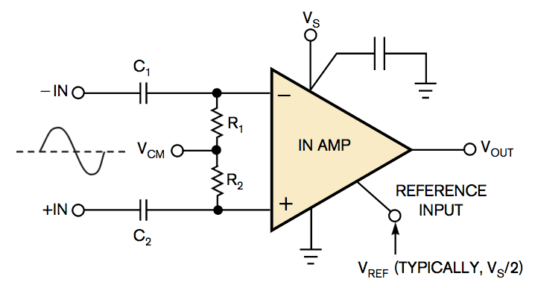
Instrumentation amplifiers are designed to overcome generic opamp caveats

Slide 26
What is an Instrumentation Amplifier?
A specialized type of differential amplifier with:
High input impedance
High common-mode rejection ratio (CMRR)
Precise gain control
Typically built using 3 op-amps or integrated as a single IC.

Slide 27
Key Advantages of Instrumentation Amplifiers
High Input Impedance:
Minimizes loading effects on the signal source.
Fixes issues caused by input bias current in standard op-amps.
High Common-Mode Rejection Ratio (CMRR):
Effectively rejects common-mode noise and interference.
Solves problems with common-mode signals in standard op-amps.
Precise Differential Amplification:
Amplifies only the difference between two input signals.
Reduces errors caused by input offset voltage and current.
Adjustable Gain:
Gain is set using a single external resistor.
Provides better control and accuracy compared to standard op-amp configurations.

Slide 28
Key Advantages of Instrumentation Amplifiers
High Input Impedance:
Minimizes loading effects on the signal source.
Fixes issues caused by input bias current in standard op-amps.
High Common-Mode Rejection Ratio (CMRR):
Effectively rejects common-mode noise and interference.
Solves problems with common-mode signals in standard op-amps.
Precise Differential Amplification:
Amplifies only the difference between two input signals.
Reduces errors caused by input offset voltage and current.
Adjustable Gain:
Gain is set using a single external resistor.
Provides better control and accuracy compared to standard op-amp configurations.

Slide 29
Key Advantages of Instrumentation Amplifiers
Low Output Impedance:
Provides a strong, low-impedance output signal.
Eliminates the need for additional buffering.
Low DC Offset and Drift:
Designed for precision applications with minimal offset voltage and drift.
Reduces errors in DC and low-frequency signal processing.
Improved Noise Performance:
Lower internal noise compared to standard op-amps.
Ideal for low-noise applications like medical devices and sensors.
Rail-to-Rail Operation (in some models):
Modern in-amps can operate close to the supply rails.
Addresses the limited dynamic range of standard op-amps.

Slide 30
Applications of Instrumentation Amplifiers
Sensor Signal Conditioning:
Amplifies weak signals from sensors (e.g., thermocouples, strain gauges).
Medical Devices:
Used in ECG, EEG, and other biomedical instruments.
Industrial Systems:
Noise-resistant signal processing in harsh environments.
Precision Measurement:
High-accuracy amplification for test and measurement equipment.

Slide 31
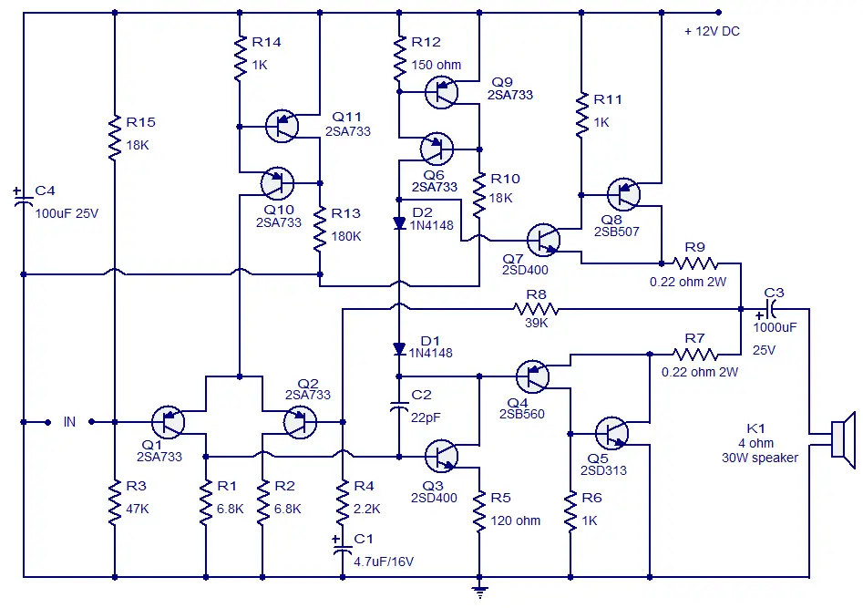
BJT Based amplifiers, attenuators, filters are available but harder to design so not as common

Slide 32
Introduction to Digital Signal Processing (DSP)
The method of analogue signal processing where the source signal is acquired by an ADC and then software processed before being regenerated by a DAC

Slide 33
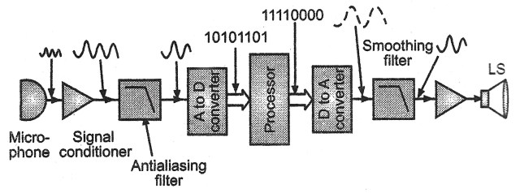
DSP FOR MICROPHONE AUDIO PROCESSING EXAMPLE

Slide 34
Noise Reduction Techniques in DSP
Digital Filtering Techniques:
Finite Impulse Response (FIR) Filters
Infinite Impulse Response (IIR) Filters
Applications of Noise Reduction (e.g., audio processing, image processing)

Slide 35
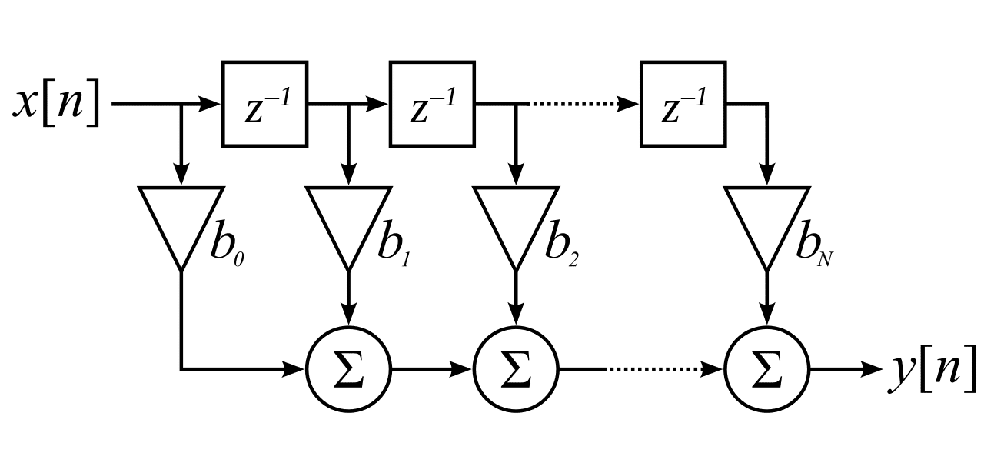
FIR Filter Diagram

Slide 36
FIR Filters
Definition: FIR filters have a finite duration impulse response.
Stability: Always stable (no feedback).
Linear Phase: Symmetric coefficients ensure linear phase response.
Structure: Non-recursive (uses only input signals, no feedback).

Slide 37
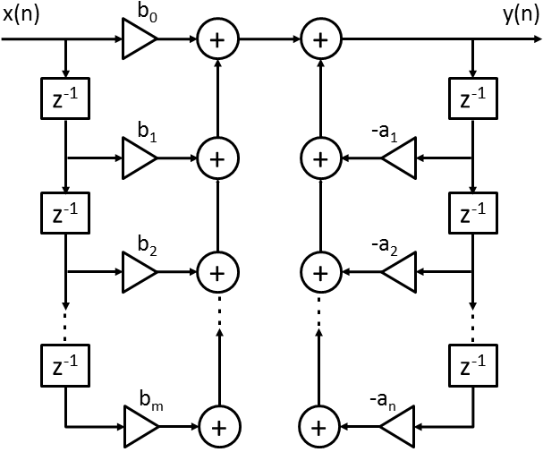

Slide 38
FIR Filters
Definition: IIR filters have an infinite duration impulse response.
Stability: Can be unstable if not designed properly (due to feedback).
Nonlinear Phase: Phase response is not linear.
Structure: Recursive (uses both input and output feedback).

Slide 39
FIR vs iir Diagram

Slide 40
Comparison
FIR Filters:
Like reading a book from start to finish without looking back.
Slow but steady and reliable.
IIR Filters:
Like reading a book but constantly revisiting previous pages.
Faster but can get confusing if not careful.

Slide 41
Comparison
Feature | FIR Filters | IIR Filters
Feedback | No feedback (one-way). | Uses feedback (loop).
Stability | Always stable. | Can be unstable.
Speed | Slower (more calculations). | Faster (fewer calculations).
Signal Shape | Preserves shape (no distortion). | May distort shape slightly.
Best Use Case | Audio, image processing. | Real-time, low-resource systems.

Slide 42
Oversampling and Averaging
Sampling a signal at a rate much higher than the Nyquist rate.
Reduces noise by spreading it over a wider bandwidth.
Combined with averaging to improve signal-to-noise ratio (SNR).

Slide 43
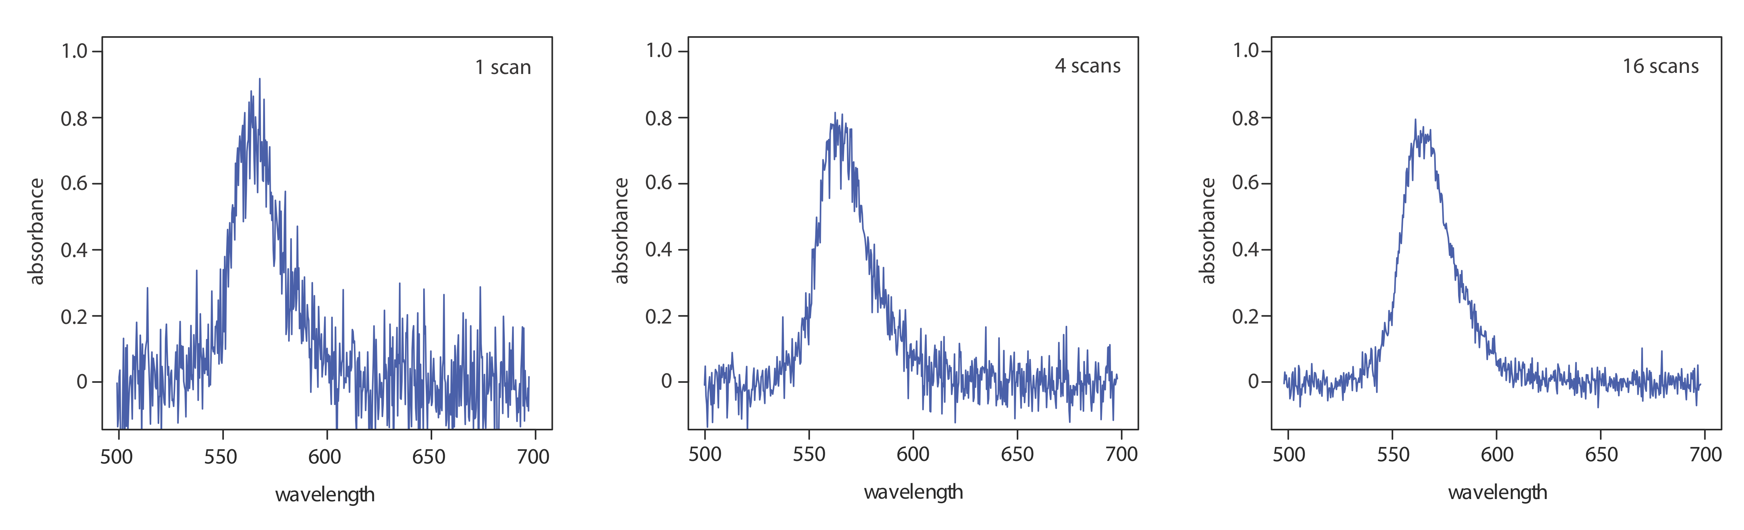

Slide 44
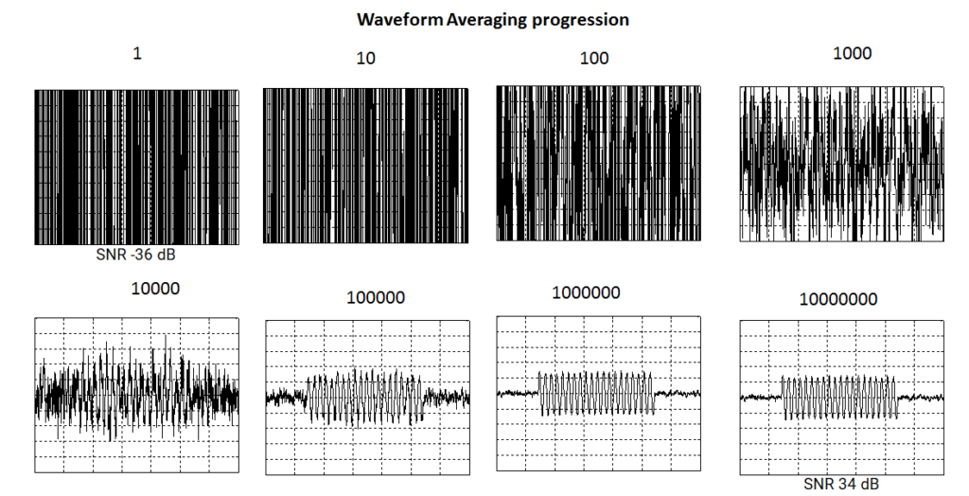

Slide 45
Windowing
A technique to reduce spectral leakage in Fourier transforms.
Multiplies the signal by a window function (e.g., Hamming, Hanning).
Tapers the signal at the edges to minimize discontinuities.

Slide 46
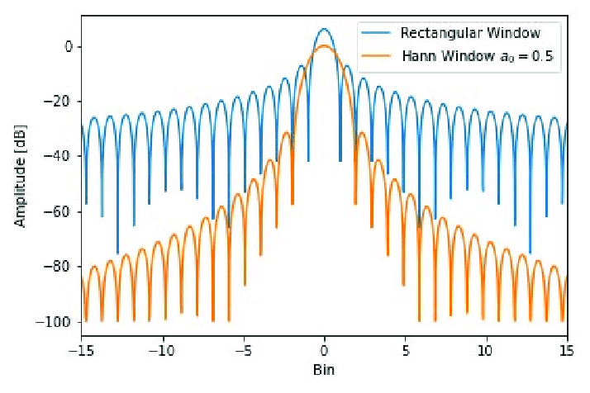

Slide 47

Frequency Bin
The frequency range and resolution on the frequency axis of a spectrum graph depends on the sampling rate and the size of the data record (the number of acquisition points).
The number of frequency points or lines or bands in the power spectrum is N_{RECORD}/2, where N_{RECORD} is the number of signal points captured in the time domain.

Slide 48
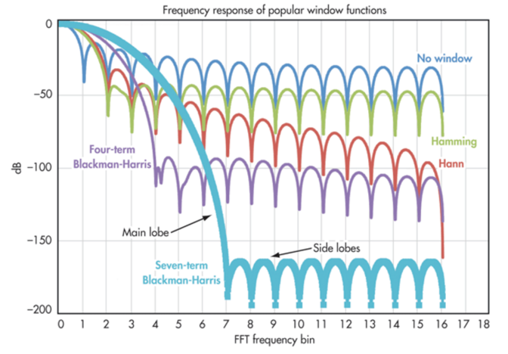

Slide 49
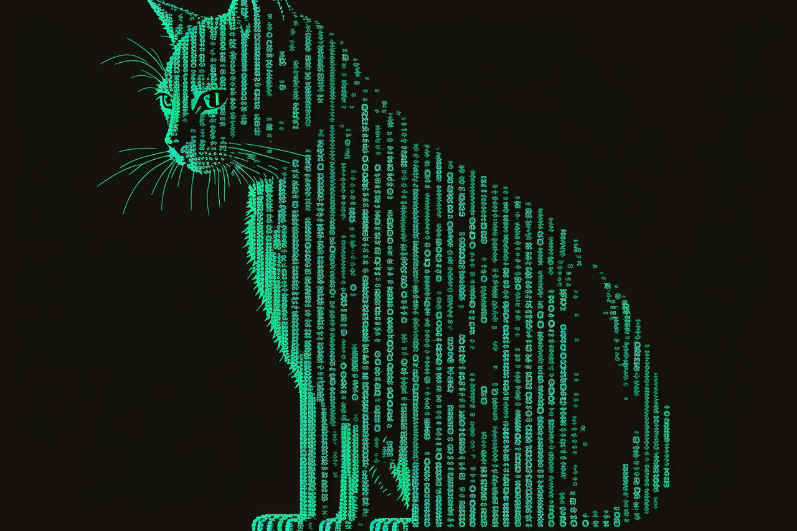
Digital SIGNALS
PROCESSING AND MAKING THEM USABLE

Slide 50
Schmitt Triggering
What is a Schmitt Trigger?
A comparator circuit with hysteresis.
Converts noisy or slow-changing signals into clean digital signals.

Slide 51
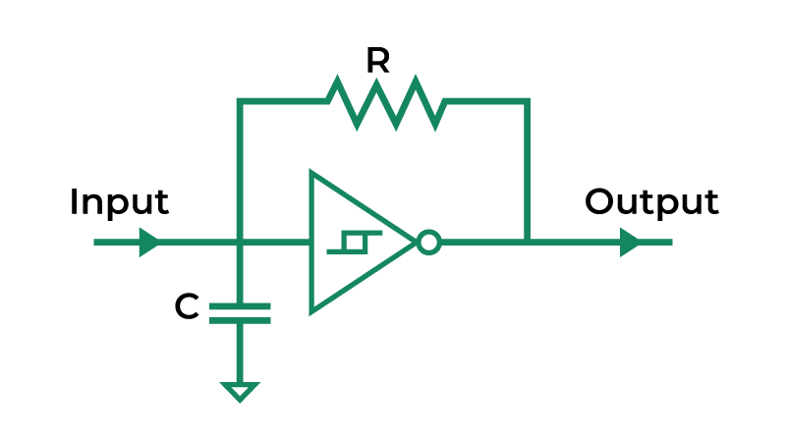
Basic diagram

Slide 52
How It Works:
Two threshold voltages: Upper Threshold (V₊) and Lower Threshold (V₋).
Output switches high when input exceeds V₊.
Output switches low when input falls below V₋.
Hysteresis prevents noise from causing false triggering.

Slide 53
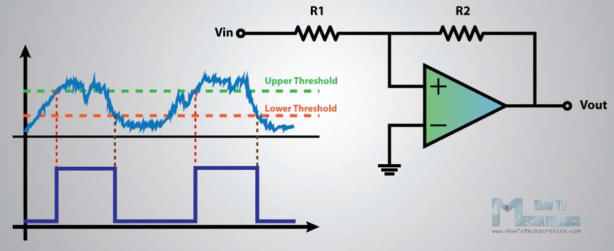

Slide 54
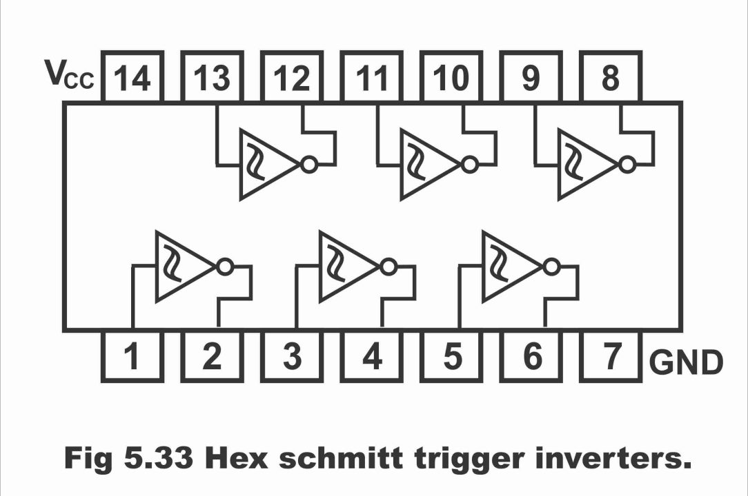
You can dedicated ICs

Slide 55
Inductor Filtering for Noise
Uses inductors to block high-frequency noise while allowing DC or low-frequency signals to pass.
Inductors oppose changes in current.
High-frequency noise is attenuated, while low-frequency signals pass through.
Often used in combination with capacitors (LC filters).

Slide 56
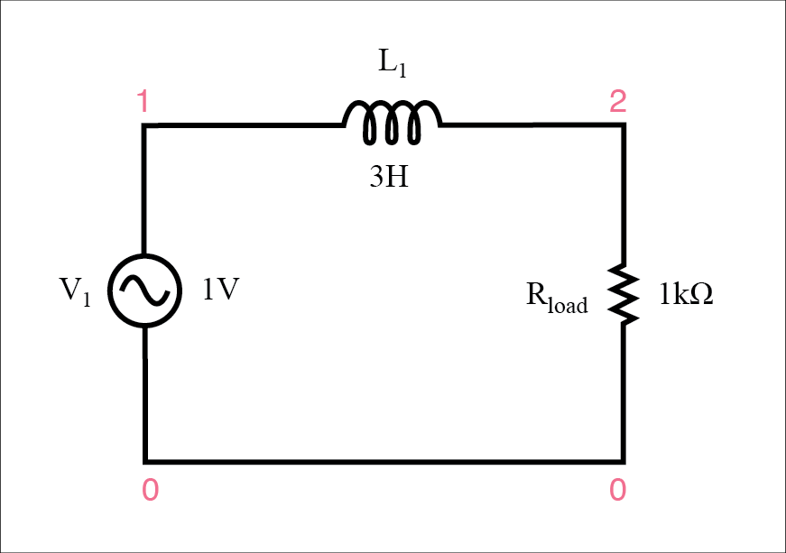

Slide 57
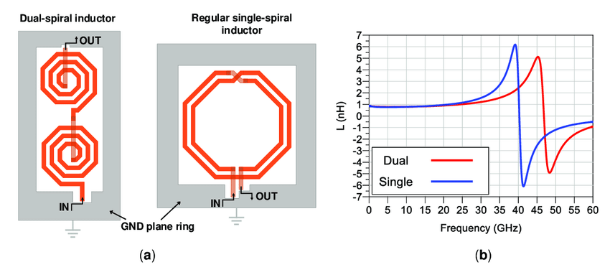

Slide 58
Capacitor Filtering for Noise
Capacitors block DC and low-frequency signals while allowing high-frequency noise to pass.
Placed in parallel with the signal path or power supply lines.

Slide 59
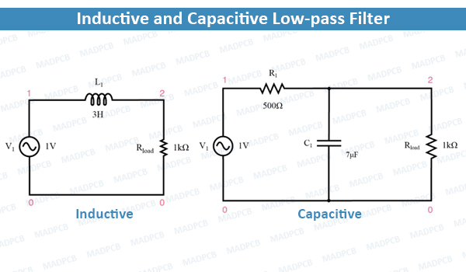

Slide 60
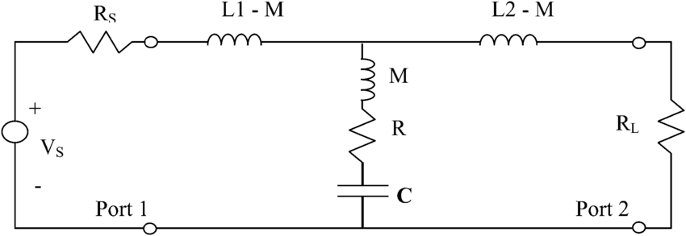

Slide 61
Impedance Matching
Ensures maximum power transfer between two circuits by matching their impedances.
Uses transformers, resistors, or LC networks to match source and load impedances.
Prevents signal reflections and losses.

Slide 62
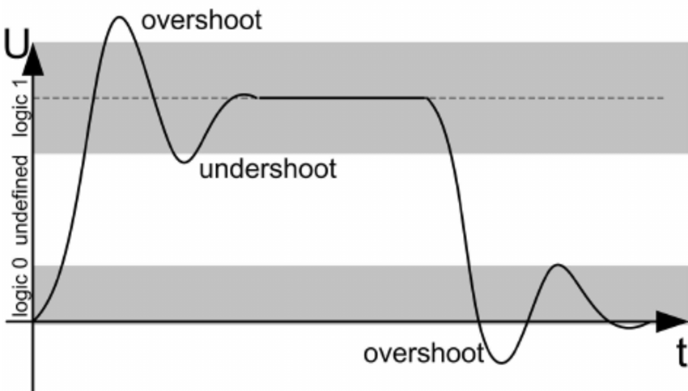
Impedance issues

Slide 63
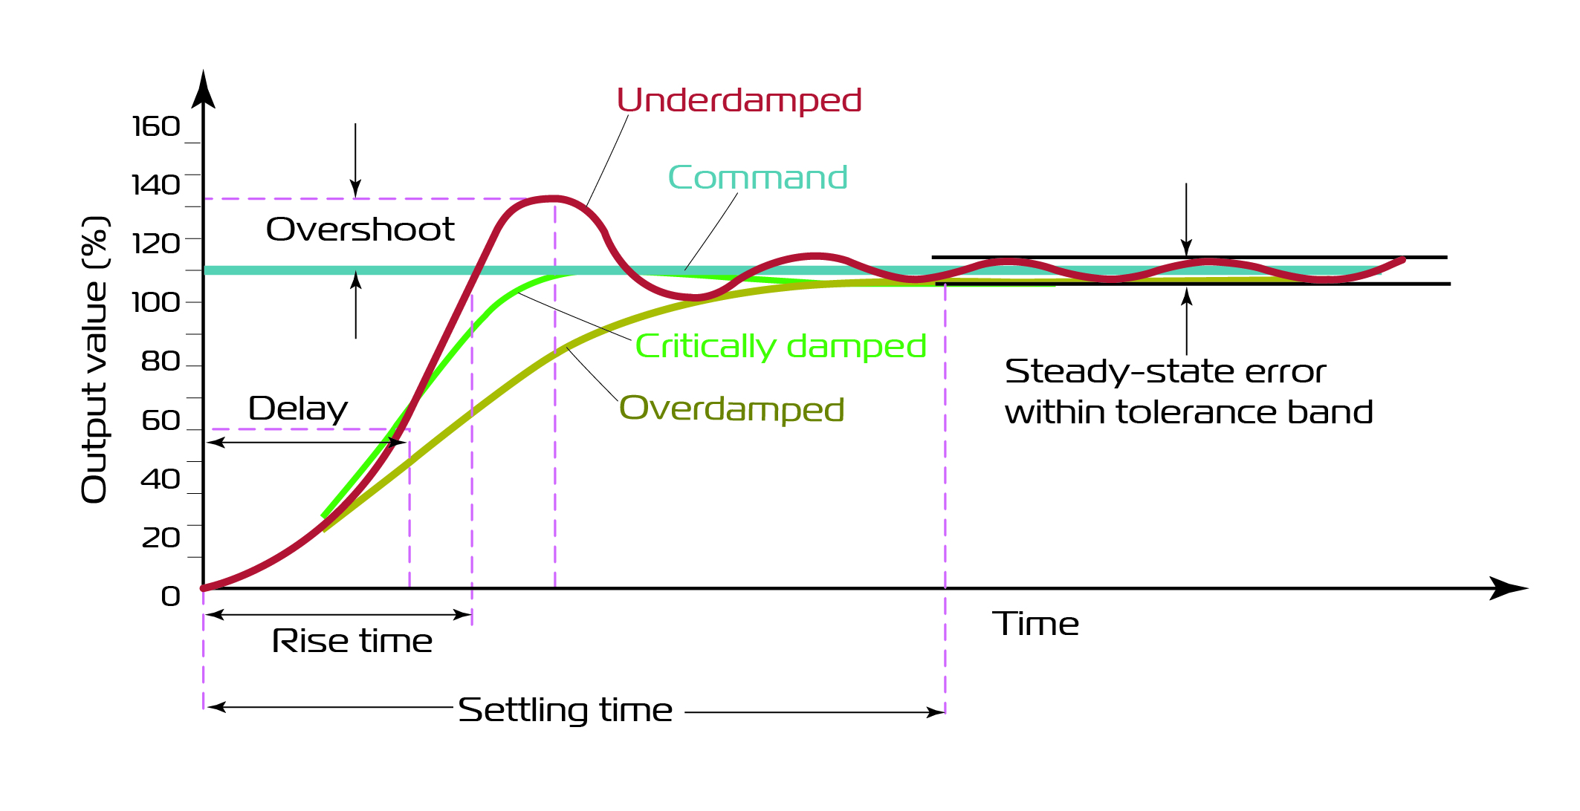
Impedance issues

Slide 64
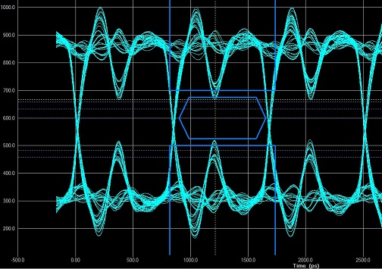
Eye diagrams

